Slide 1
Product Presentation
MQK30 – Multi-Directional Forklift

Slide 2
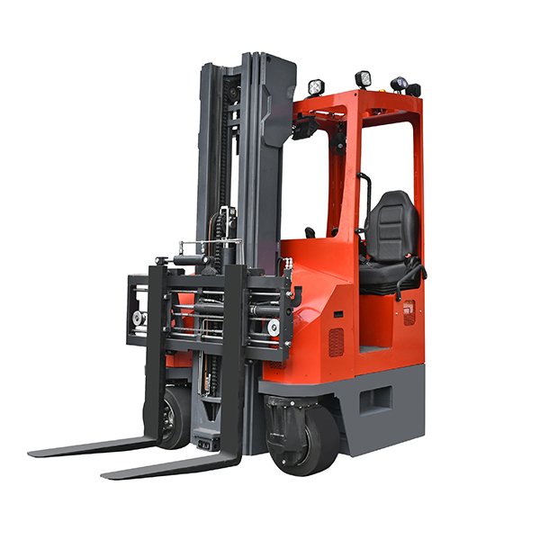
MiMA MQK30
Contents
Overview
Applied industry
Product Features
Options
Marketing Tools

Slide 3
MiMA MQK30
Contents
Overview
Applied industry
Product Features
Options
Marketing Tools

Slide 4
MiMA MQK30
Product Introduction
MQK30 Multi-directional Counterbanlance Forklift
Load Capacity:3000kg

Slide 5
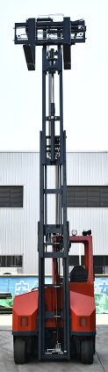
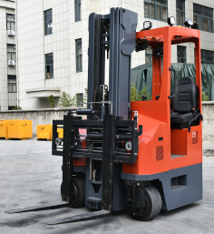
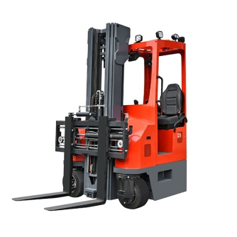
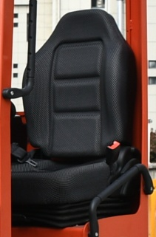
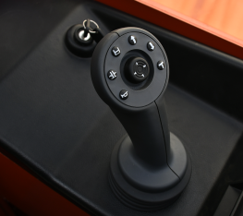
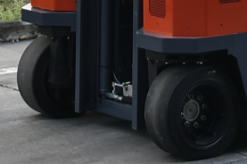
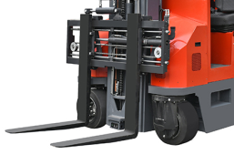
MiMA MQK30
Highlights
Load Capacity:3000kg
With a maximum lifting height of 8 meters and a high-precision mast. It is equally capable at high loads.
Integrated joystick for comfortable, safe and stable operation.
OPS suspension seat, ride comfortably, when the operator leaves the seat, the whole forklift stops immediately, operation safety.
MQK30
Equipped with fork positioner + side shifter, wide adaptability, high working efficiency.
Solid tires, can be used both indoor and outdoor. Dual-drive brake: better braking effect, can be used on slippery and icy ground, safer for operators.

Slide 6
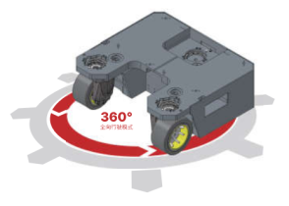

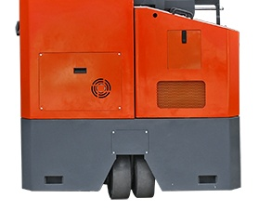
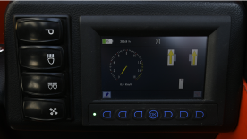
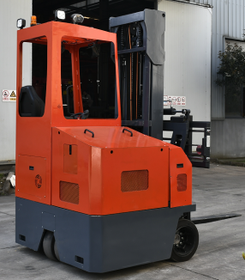
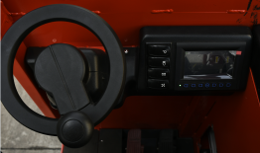
MiMA MQK30
Highlights
Various driving modes such as straight walk, sidewalk, and center rotation
360° multi-directional mode + non-stop continuous operation mode, high flexibility and efficiency
Multi-function intelligent instrument panel with wheel display, more comfortable and convenient operation
Full AC system design, using AC brushless motor, with high efficiency and energy saving, to meet the requirements different operations under heavy working conditions.
MQK30
Standard high-capacity lithium battery, strong battery life
Equipped with electronic steering, which makes steering more labor-saving, reduces fatigue intensity and improves working efficiency.

Slide 7
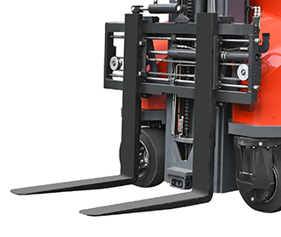
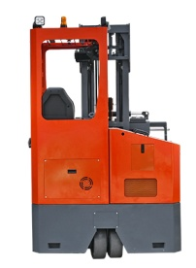
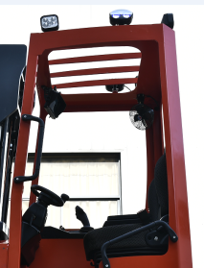
Overview
Details of Products
Forks
Forklift Body
Overhead guard

Slide 8
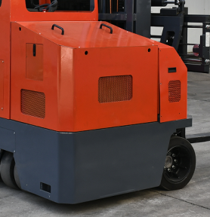
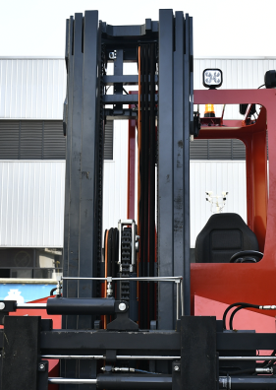
Overview
Details of Products
Battery
Mast
Hoisting Battery
Full Free Triplex Mast 3.6-8.0 meters

Slide 9
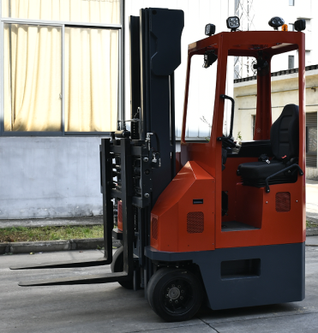
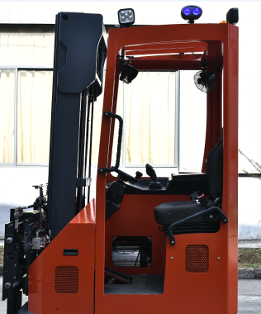
Overview
Details of Body
Forklift body
Cabin

Slide 10
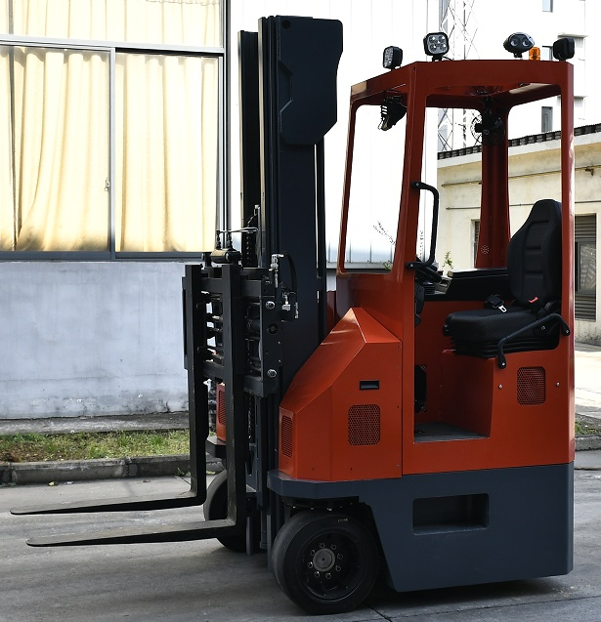
Overview
Overhead guard and cabin
Overhead guard and cabin Height.
2650/2515(with lamp height/without lamp) overhead guard and cabin height

Slide 11
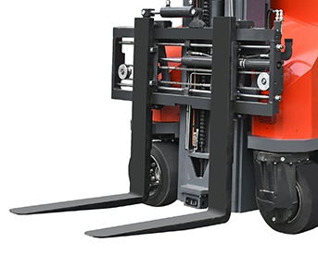
Overview
Forklift Systems
Fork system.
fork positioner + side shifter

Slide 12
Overview
Energy Management - Lithium
Type | Voltage (V) | Battery Capacity(Ah)
 |  |  | Lithium Battery | Lead-acid Battery
Hoisting Battery | 48V | 600AH | • | ○
48V/880AH lead-acid battery is optional now.
•Standard.,  Optional.,

Slide 13
Overview
Mast parameter
Triplex full free mast
Model | MQK30SQ | 30SQ-36 | 30SQ-40 | 30SQ-46 | 30SQ-54 | 30SQ-60 | 30SQ-65 | 30SQ-70 | 30SQ-75 | 30SQ-80
Lift Height | h3(mm) | 3600 | 4000 | 4600 | 5400 | 6000 | 6500 | 7000 | 7500 | 8000
Mast extended height | h4(mm) | 4960 | 5360 | 5960 | 6760 | 7360 | 7860 | 8360 | 8860 | 9360
Mast closed height | h1(mm) | 1935 | 2068 | 2268 | 2535 | 2735 | 2902 | 3018 | 3184 | 3351
Free lift height | h2(mm) | 575 | 708 | 908 | 1175 | 1375 | 1542 | 1658 | 1824 | 1991

Slide 14
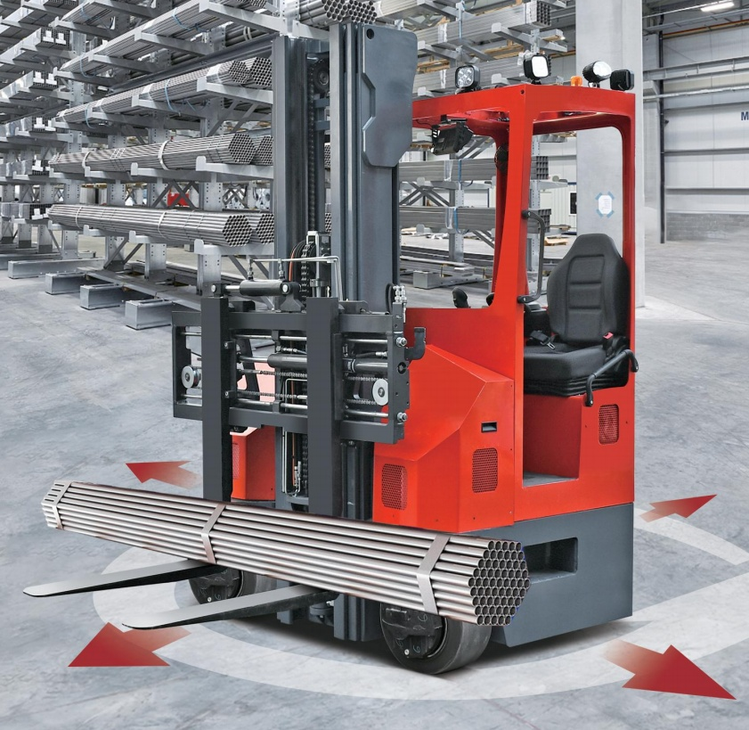
MiMA TFC30/35
Overview
Overview
Applied industry
Product Features
Options
Marketing Tools

Slide 15
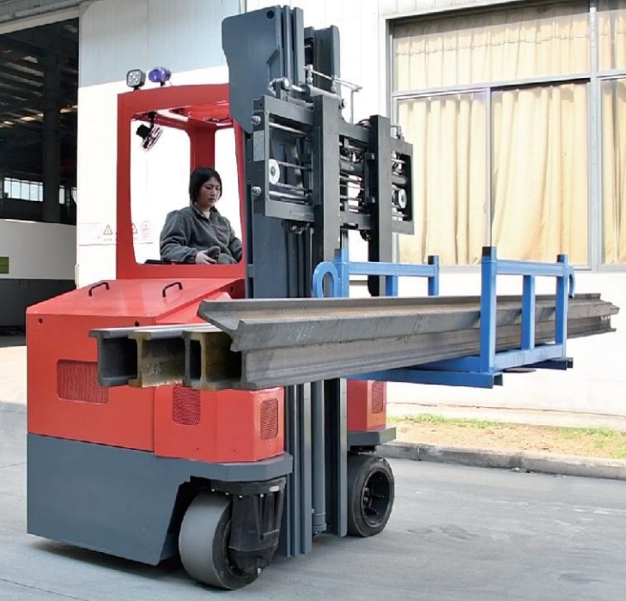
Applied industry
Application
Industry
    It is suitable for the handling and stacking of long materials, such as profiles, plates, wood, molds and curtain walls.
    Suitable for:
    -Stacking in narrow aisles
    -Stacking of long materials.

Slide 16
MiMA MQK30
Overview
Overview
Applied industry
Product Features
Options
Marketing Tools

Slide 17
MiMA MQK30
Product Features
safe
simple
powerful
flexible

Slide 18
MiMA MQK30
Product Features-Simple
Product Features |  | Customer Benefits
Ergonomic Design Cabin |  | Adjustable steering wheel and seat for all-around operational comfort
Integrated Joystick |  | Versatile, easy and comfortable to operate
Multi-functional Intelligent Instrument |  | With wheel display function, more comfortable and convenient operation
Fork positioner+ Side Shifter |  | Forks can be automatically adjusted to suit for different long material handling and stacking.
Electronic Steering System |  | More effortless steering, reduced fatigue and improved efficiency
Simple
Powerful
Safe
Flexible

Slide 19
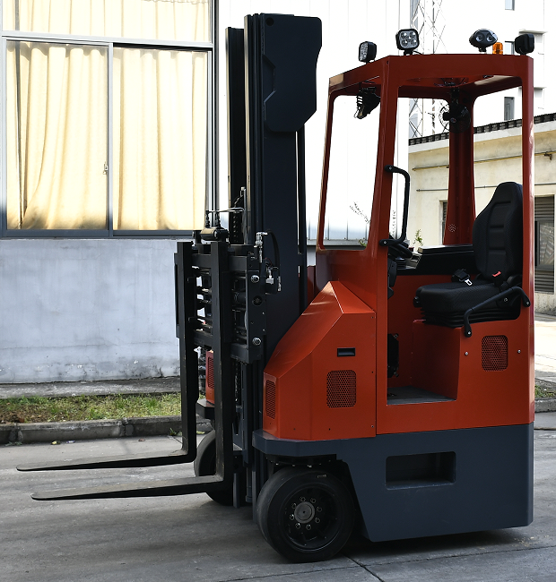
MQK30
Ergonomically Designed Cab
-Ergonomic design cabin, OPS suspension seat, comfortable ride, when the operator leaves the seat, the whole forklift stops immediately, safe operation.
Simple
Powerful
Safe
Flexible

Slide 20
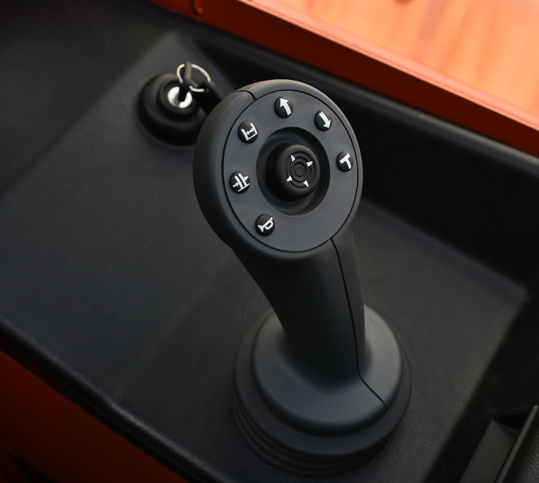
MQK30
Integrated Joystick
Standard intergrated Joystick versatile, easy and comfortable to operate
Simple
Powerful
Safe
Flexible

Slide 21
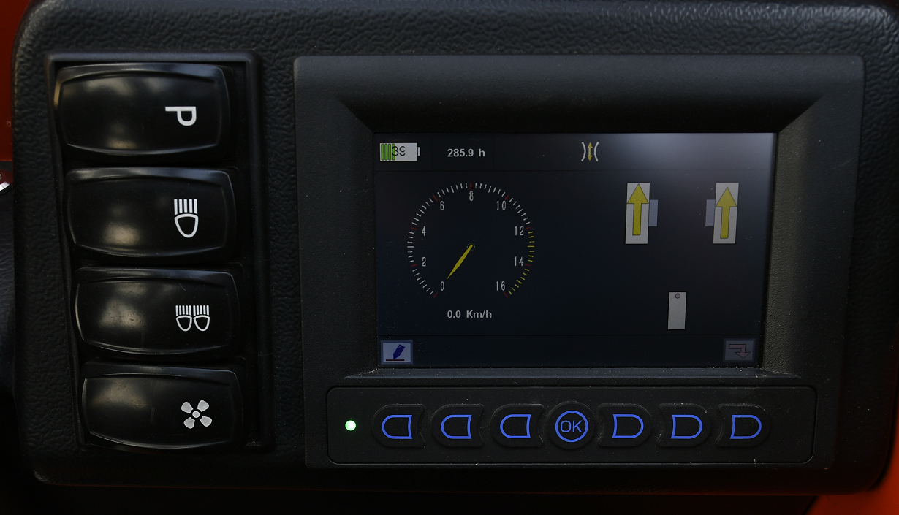
MQK30
Multi-functional Intelligent Instrument
Multi-function intelligent color instrument, can display the whole forklift driving wheel status, working time, power, parking situation, driving speed, fault code and interface management and other information, easy to adjust the direction in the aisle, safe and reasonable, accurate identification
Simple
Powerful
Safety
Flexible

Slide 22
MQK30
Automatic Fork Position Function
  Equipped with fork positioner + side shifter, it has wide adaptability and high working efficiency in order to adapt to the handling and stacking of long materials with different needs.
Simple
Powerful
Safe
Flexible

Slide 23
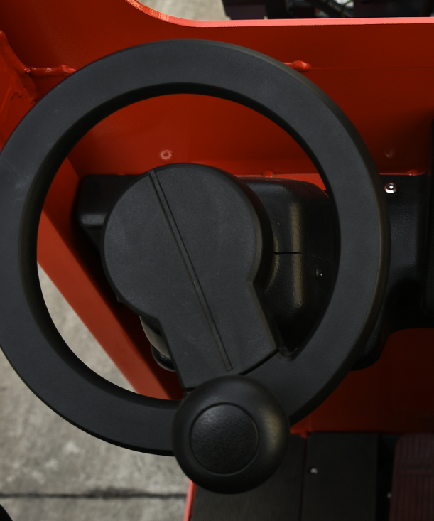
MQK30
Electric Steering system
  Electric steering system saves energy, makes operating comfort, reduces fatigue intensity and improves efficiency.
Simple
Powerful
Safe
Flexible

Slide 24
MiMA MQK30
Product Features-Powerful
Product Features |  | Customer Benefits
AC Maintenance-Free Drive System |  | Strong power, long work life and low energy consumption
Curtis Brand Controller |  | Powerful, stable performance, intelligent self-diagnosis, less failure rate
High-precision Mast |  | High-precision mast with excellent capacity for ultra-high loads.
Large capacity Lithium Battery |  | Strong power meets the needs of different working conditions
Simple
Powerful
Safe
Flexible

Slide 25
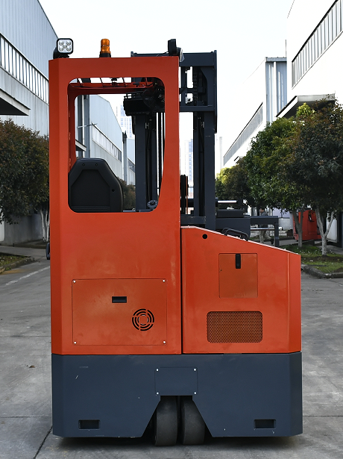
MQK30
AC Maintenance-Free Drive System
The full-AC system design with AC brushless motor is highly efficient and energy-saving, which meets the requirements of many operations under heavy working conditions.
Simple
Powerful
Safe
Flexible

Slide 26
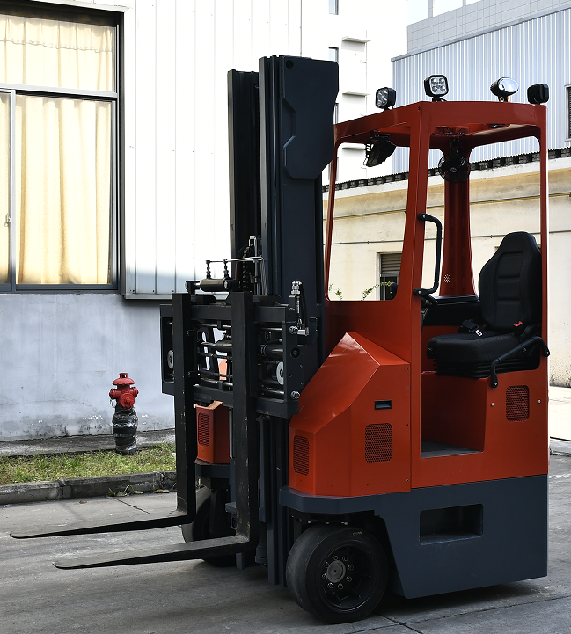
MQK30
CURTIS Brand Controllers
Adopt advanced CURTIS brand controller, powerful, stable performance, intelligent self-diagnosis, less failure rate
Simple
Powerful
Safe
Flexible

Slide 27
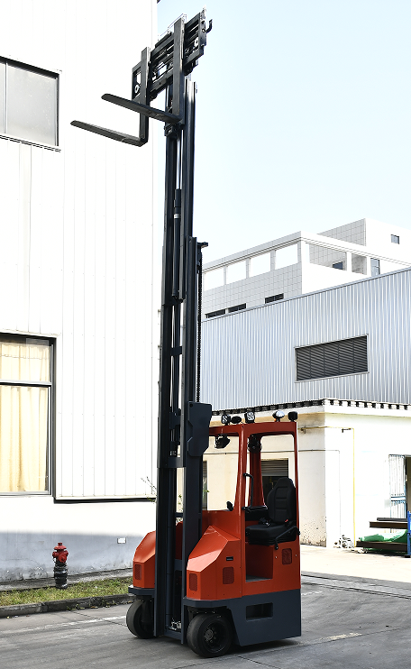
MQK30
High-precision Mast
  Adoption of high-precision mast system, the ability is excellent at ultra-high loads
Simple
Powerful
Safe
Flexible

Slide 28
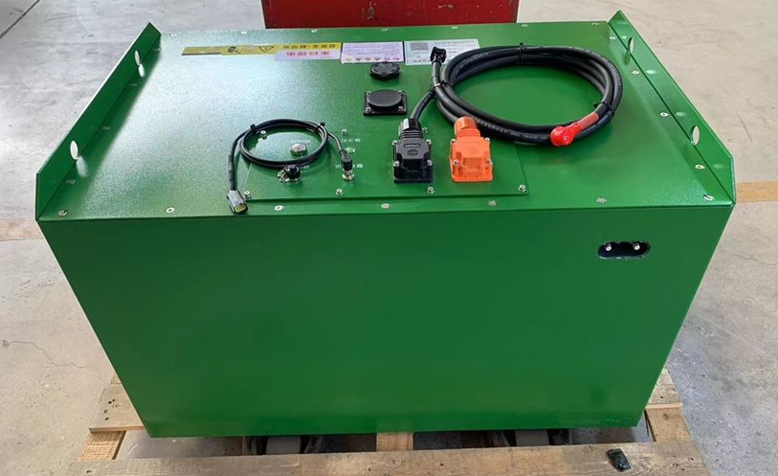
MQK30
Large Capacity Battery
  Standard 48V460AH lithium battery, maintenance-free, convenient charging, full charger just need 2-3 hours, safe and reliable, long cycle life, to meet the needs of different working conditions
Simple
Powerful
Safe
Flexible

Slide 29
MiMA MQK30
Product Features-Safe
Product Features |  | Customer Benefits
Wireless Video Assist System |  | Enhanced vision to improve operational safety and efficiency
OPS Suspension Seat |  | Comfortable ride and safe operation
Dual-drive brakes |  | Better braking effect, can be used in slippery, icy ground, the operator work more safely.
Emergency Stop Switch |  | In case of emergency, the emergency stop switch can quickly cut off the power of the whole forklift.
Safety Warning/Blue Lights |  | Provide warnings to people around the forklift and prevent safety hazards
Simple
Powerful
Safe
Flexible

Slide 30
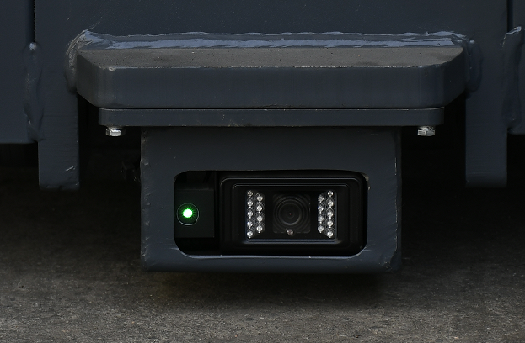
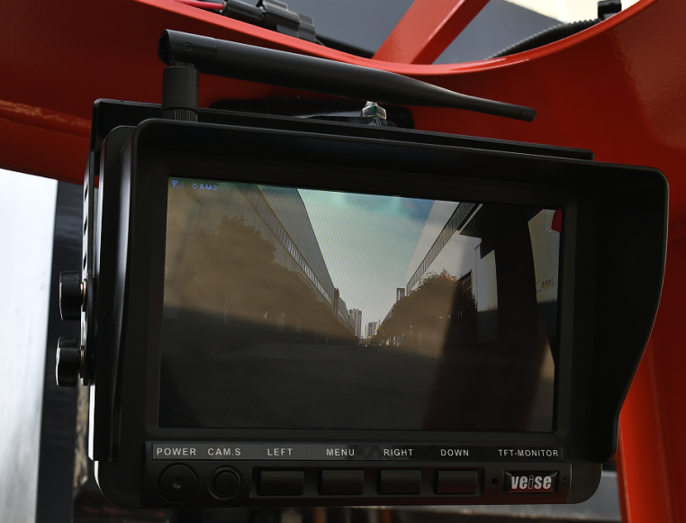
MQK30
Wireless Video Assist System
    Equipped with wireless camera and high-definition video color display, the camera is used for high level stacking to show the position of forks and shelves or goods. The display is used for high level stacking to show the stacking status of goods, which enhances the view of high level stacking, and improves the safety and efficiency of operation.
Simple
Camera
Color Display screen
Powerful
Safe
Flexible

Slide 31
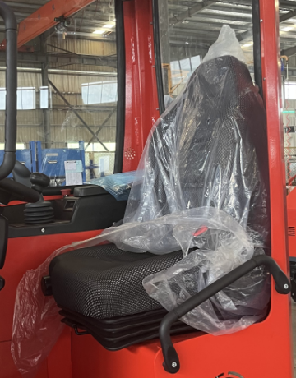
MQK30
OPS Suspension Seat
Adopting OPS suspension seat, when the operator leaves the seat, the whole forklift stops immediately to prevent misoperation and ensure safe operation.
Simple
Powerful
Safe
Flexible

Slide 32
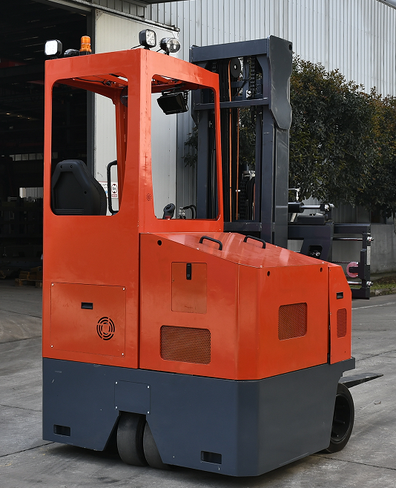
MQK30
Full-wheel brakes
Dual-drive brake: better braking effect, can be used in slippery, icy ground, the operator work more safely.
Simple
Powerful
Safe
Flexible

Slide 33
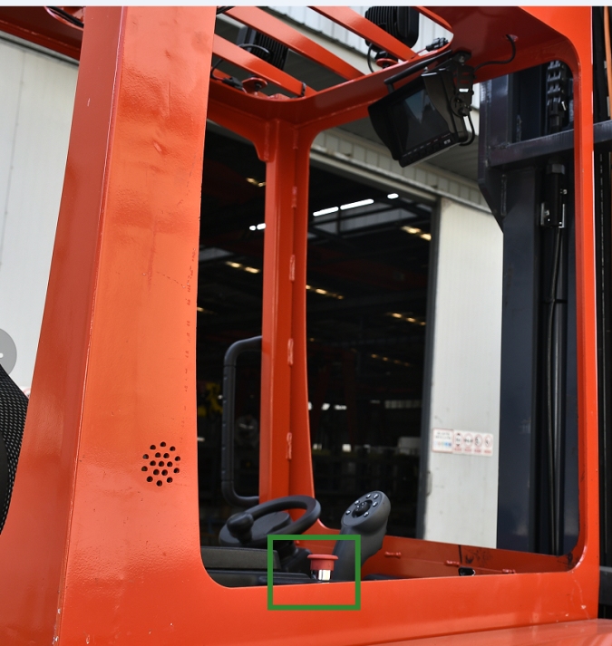
MQK30
Emergency Stop Switches
Emergency stop switch, used in emergency situations to quickly cut off the power supply and operation of the entire forklift, to ensure safety
Simple
Powerful
Safe
Flexible

Slide 34
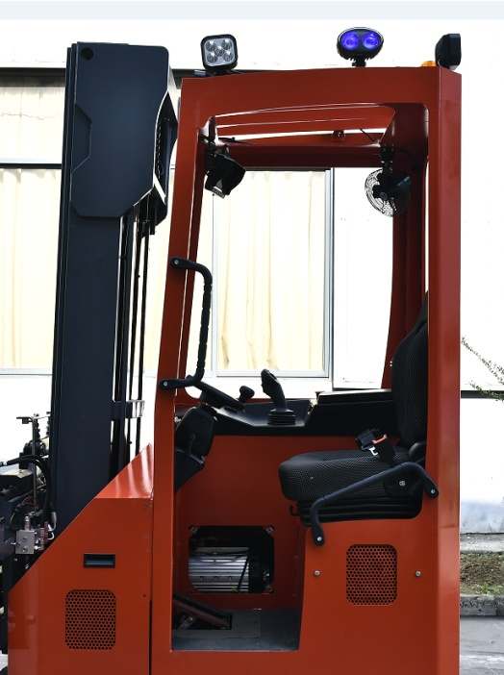
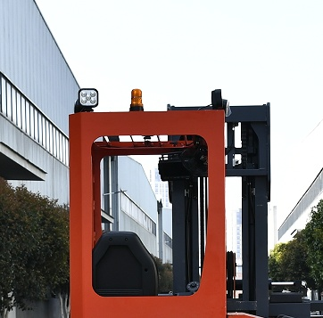
MQK30
Safety Warning Light/Blue Light
    Equipped with a warning light/blue light to provide work warning to the surrounding people during the work and prevent potential safety hazards.
Simple
Powerful
Safe
Flexible

Slide 35
MiMA MQK30
Product Features - Flexibility
Product Features |  | Customer Benefits
All Wheel Solid Rubber Tires |  | Suitable for indoor and outdoor work
360° multi-directional mode + non-stop continuous operation mode |  | High flexibility and efficiency
Enclosed cabins are available |  | Suitable for cold storage, outdoor work in winter, etc.
Standard with fork positioner + side shifter |  | Wide adaptability, high work efficiency to meet the different specifications of long material handling needs.
Simple
Powerful
Safe
Flexible

Slide 36
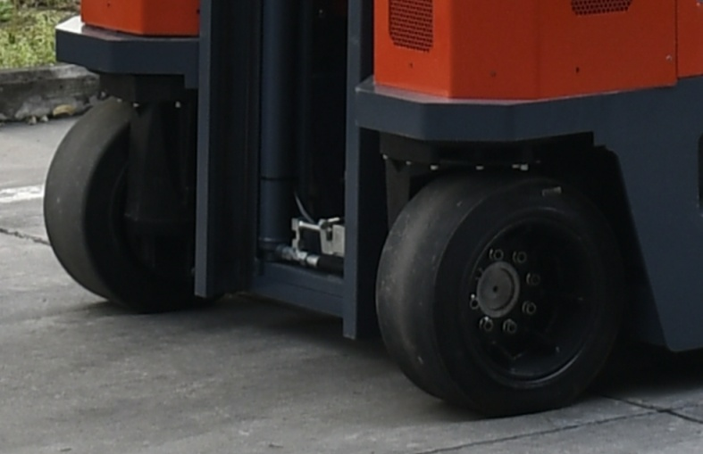
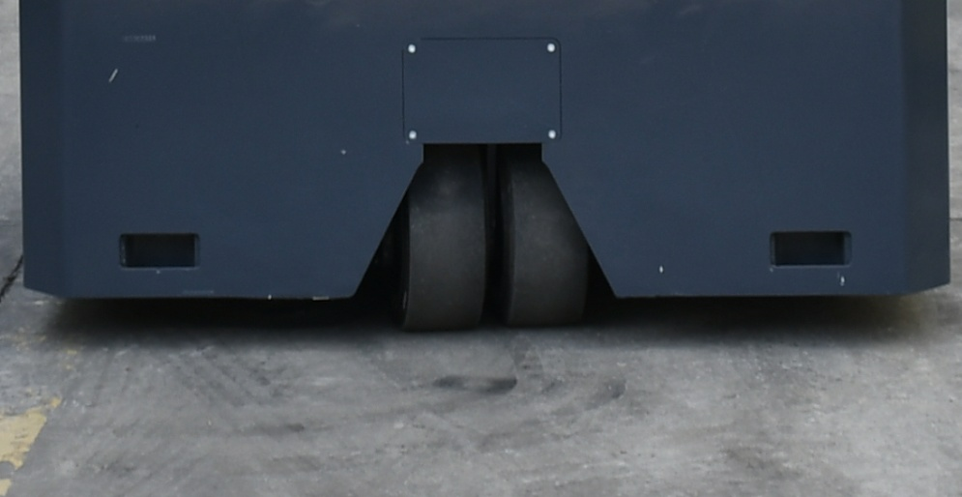
MQK30
All Wheel Rubber Tires
    All-wheels are solid rubber tires, road adaptability, both for indoor and outdoor work
Simple
Powerful
Safe
Flexible

Slide 37
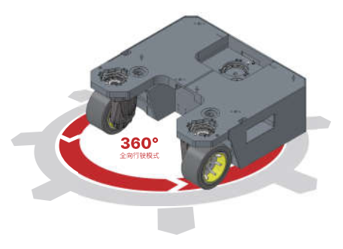
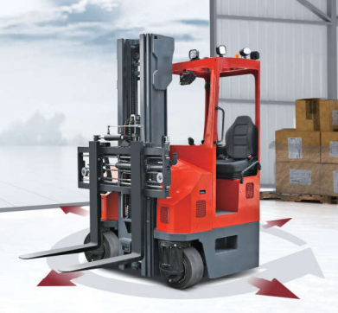
MQK30
Humanized Design
360° Multi-directional mode + non-stop continuous operation mode, high flexibility and efficiency
Simple
Powerful
Safe
Flexible

Slide 38
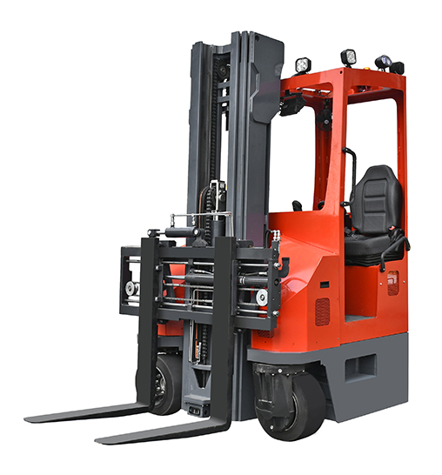
MQK30
Customized Enclosed Cabin
Non-standard customized fully enclosed cabin, to meet the requirements of different working conditions, such as cold storage operations, outdoor winter operations, etc.
Simple
Powerful
Safe
Flexible

Slide 39
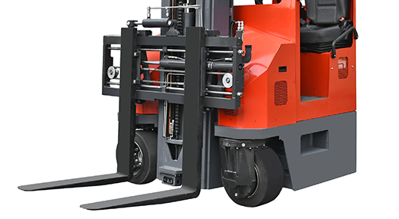
MQK30
Four-way Fork
Standard with fork positioner+ side shifter, wide adaptability, high work efficiency to meet the needs of different specifications of long material handling.
Simple
Powerful
Safe
Flexible

Slide 40
MiMA MQK30
Overview
Overview
Applied industry
Product Features
Options
Marketing Tools

Slide 41
MiMA MQK30
Configurations
 |  | Standard Configuration | Optional Configuration
Configurations | Fork positioner + Side Shifter | ● | ○
 | Integrated joystick | ● | ○
 | Non-stop Continuous Direction Switching | ● | ○
 | Enclosed Cabin | ○ | ●
 | Lithium Battery | ● | ○
 | Suspension seat | ● | ○
 | OPS | ● | ○
 | Blue Light | ● | ○
 | Color Video Display | ● | ○
 | LED Light | ● | ○
 | Warning Light | ● | ○
 | Toolboxes | ● | ○

Slide 42
MiMA MQK30
Overview
Overview
Applied industry
Product Features
Options
Marketing Tools

Slide 43
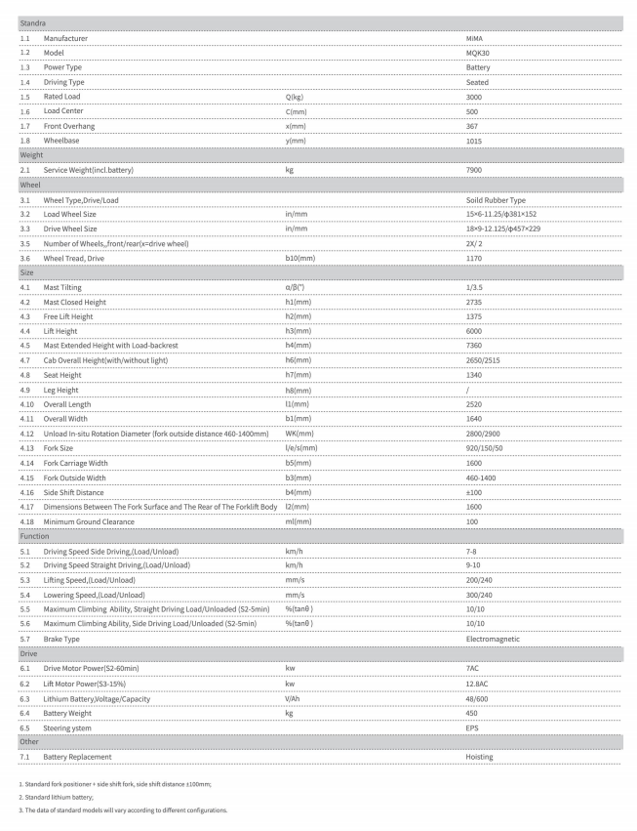
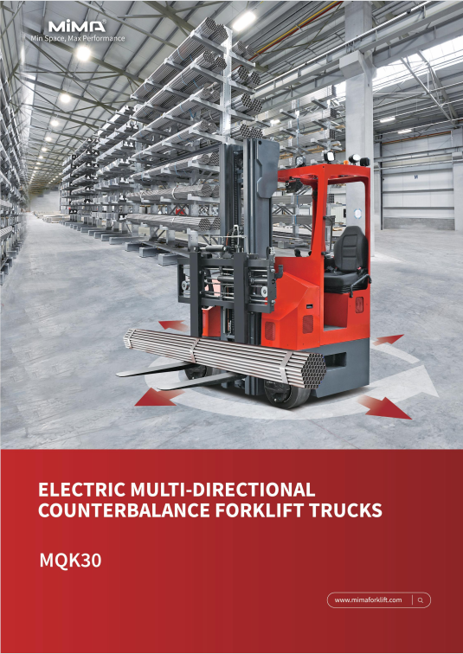
Marketing Tools
Technical Parameters
Commercial Brochure
Web Address
  www.sglift.es
  www.sglift.es

